Slide 1

SCALA

Slide 2
Contents
Conditions
Loops
Classes and Objects
Structure of Classes
Expressions Vs Statements
Tuples

Slide 3
Conditions
A conditional statement is the one which executes a block of code when a certain condition is fulfilled.
Conditional statements help the program in decision making.
Control statements or conditional statement decide which block of code need to be executed based on certain criteria.

Slide 4
In Scala, the following conditional statements are valid:
if condition: execute block if a condition is true.
if - else condition: execute a block if a condition is true otherwise execute another block.
Nested if-else: It checks for another condition inside the conditional block. If condition inside if condition.
if-else if Ladder: Used when multiple conditions need to be checked.

Slide 5

if conditional statement
If the condition is used when the user needs to choose between only one condition. This lets program execute a block if the condition is true otherwise continue with the flow of the program.
Block execute if condition in the statement is TRUE otherwise nothing is done.
Syntax:

Slide 6
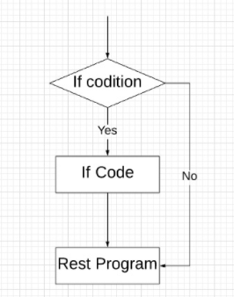
Control flow diagram:

Slide 7
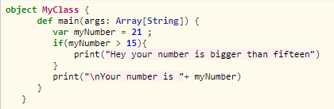

Example code:
Output

Slide 8
Example explanation:
In the above example, the If condition check weather myNumber is greater than 15.
If it's greater than fifteen the code prints: "Hey your number is bigger than fifteen" If myNumber is not greater than 15 the code continues it general flow.
if-else conditional statement
if-else condition is used when the user needs to choose between two conditions.

Slide 9
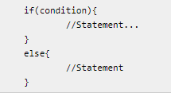
This lets program execute a block if the condition is true otherwise execute another block of code and then continue with the flow of the program.
Block execute if condition in the statement is TRUE otherwise another block of code is executed.
Syntax:

Slide 10
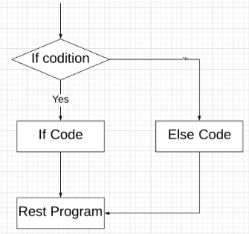
Control flow diagram:

Slide 11
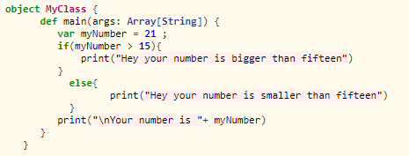

Example code:
Output

Slide 12
Example explanation:
In the above example, the If condition check weather myNumber is greater than 15.
If it's greater than fifteen the code prints: Hey your number is bigger than fifteen
If myNumber is not greater than 15 the code prints: Hey your number is smaller than fifteen and then the code flow continues.
Nested if-else conditional statement
Nested if-else condition is used when the user needs to choose between a condition that is inside other condition.

Slide 13
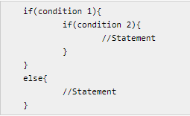
The flow goes into the first condition then inside the block of code anther condition which executes to execute another block of code.
Block execute if condition in the statement is TRUE otherwise another block of code is executed. I
f the first block of code is executed then inside this block there is another conditional statement that leads to another block of code.
Syntax:

Slide 14
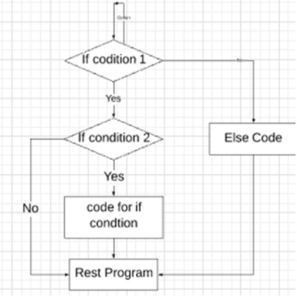
Control flow diagram:

Slide 15
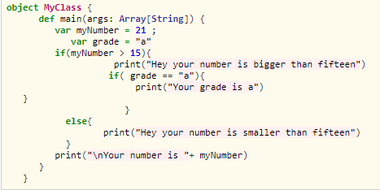

Example code:
Output

Slide 16
Example explanation:
In this code, two variables are defined as myNumber and grade.
First condition checks for myNumber, if it is greater than 15 than the flow gets into the block and prints "Hey your number is bigger than fifteen". then it checks the condition for the grade, if the grade is equal to "a" then it prints "Your grade is a".
If myNumber is not greater than 15 then code execute the else statement that is Hey your number is smaller than fifteen. And finally goes through the rest code of the program.

Slide 17
If-else if Ladder
In the if-else-if loop, the code flow into multiple conditions and if one goes FALSE, then another condition is executed and the condition checks go on. If all the conditions are FALSE, then finally, the else block is executed.
The flow goes on with checking conditions one by one. Until any one condition gets TRUE or the final else condition comes.

Slide 18
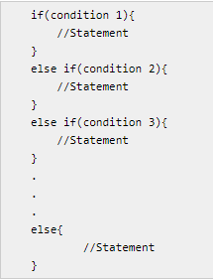
Syntax:

Slide 19
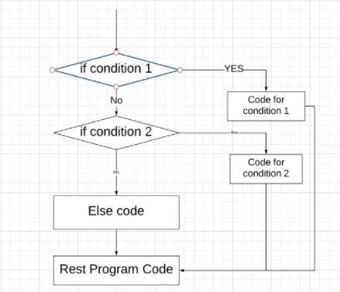
Control flow diagram:

Slide 20
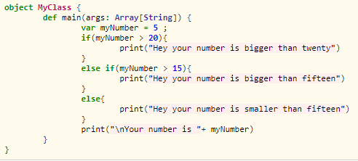

Control flow diagram:
Output

Slide 21
Example explanation:
In this code, the program initializes one variable muNumber.
Then it checks the value of myNumber to be greater than 20 in the first condition if the condition is true the code prints "Hey your number is bigger than Twenty".
If this gets FALSE than it is checked for value to be greater than 15 in the second condition if this gets TRUE than the code prints "Hey your number is bigger than fifteen".
At last, if all conditions are FALSE, it goes to the else condition that will execute when all are FALSE and the code prints "Hey your number is smaller than fifteen". After the execution of the else loop, the remaining code will get executed.

Slide 22
Loops
There may be a situation, when you need to execute a block of code several number of times. In general, statements are executed sequentially: The first statement in a function is executed first, followed by the second, and so on.
Programming languages provide various control structures that allow for more complicated execution paths.
A loop statement allows us to execute a statement or group of statements multiple times and following is the general form of a loop statement in most of the programming languages

Slide 23
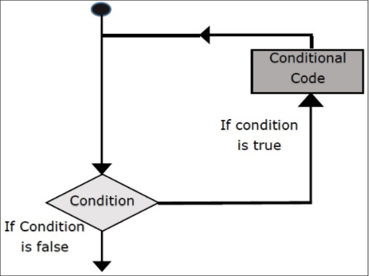
Flow chart

Slide 24
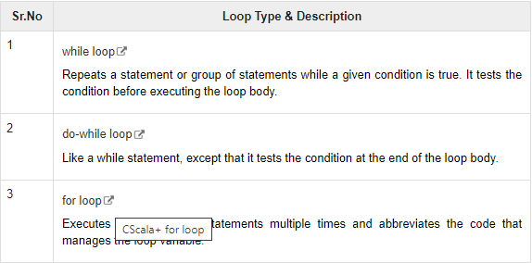
Scala programming language provides the following types of loops to handle looping requirements.

Slide 25
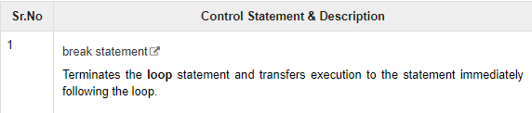
Loop Control Statements
Loop control statements change execution from its normal sequence.
When execution leaves a scope, all automatic objects that were created in that scope are destroyed.
As such Scala does not support break or continue statement like Java does but starting from Scala version 2.8, there is a way to break the loops.

Slide 26
The infinite Loop
A loop becomes an infinite loop if a condition never becomes false. If you are using Scala, the while loop is the best way to implement infinite loop.

Slide 27
Classes and Objects
A class is a blueprint for objects.
Once you define a class, you can create objects from the class blueprint with the keyword new.
Through the object you can use all functionalities of the defined class.

Slide 28
The following diagram demonstrates the class and object by taking an example of class student, which contains the member variables (name and roll no) and member methods (setName() and setRollNo()).
Finally all are members of the class. Class is a blue print and objects are real here.
In the following diagram, Student is a class and Harini, John, and Maria are the objects of Student class, those are having name and roll-number.

Slide 29
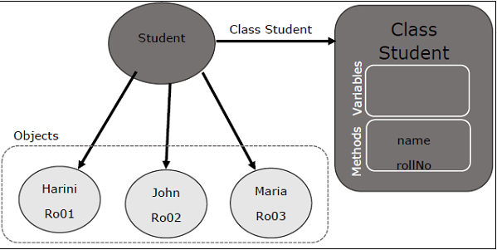

Slide 30
Basic Class
Following is a simple syntax to define a basic class in Scala.
This class defines two variables x and y and a method: move, which does not return a value. Class variables are called, fields of the class and methods are called class methods.
The class name works as a class constructor which can take a number of parameters.
The above code defines two constructor arguments, xc and yc; they are both visible in the whole body of the class.

Slide 31
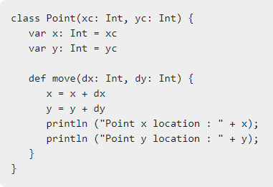
Syntax

Slide 32
Extending a Class
You can extend a base Scala class and you can design an inherited class in the same way you do it in Java (use extends key word), but there are two restrictions: method overriding requires the override keyword, and only the primary constructor can pass parameters to the base constructor.

Slide 33
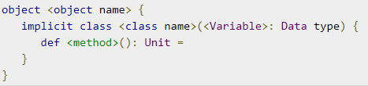
Implicit Classes
Implicit classes allow implicit conversations with class’s primary constructor when the class is in scope. Implicit class is a class marked with ‘implicit’ keyword.
Syntax
The following is the syntax for implicit classes. Here implicit class is always in the object scope where all method definitions are allowed because implicit class cannot be a top level class.

Slide 34
Singleton Objects
Scala is more object-oriented than Java because in Scala, we cannot have static members. Instead, Scala has singleton objects.
A singleton is a class that can have only one instance, i.e., Object.
You create singleton using the keyword object instead of class keyword.
Since you can't instantiate a singleton object, you can't pass parameters to the primary constructor.

Slide 35
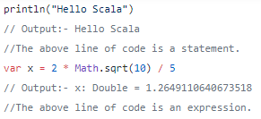
Expressions Vs Statements
A statement is the smallest standalone element that expresses some action to be carried out.
Whereas an expression in a programming language is something that produces or returns a value.
Here is an example.

Slide 36
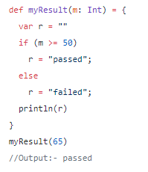
With this information, We can say that a program is nothing but a sequence of statements and expressions.
Let's look at an example.

Slide 37
If you carefully look at this small program, you can extend the definition of a program.
We can now say that a program is nothing but a sequence of statements and expressions that modify some program state.
In this program, we have an if statement and then we have a print statement. Both of these statements are modifying something.
The if statement is changing the state of r and print statement changes the state of the console.

Slide 38
All the I talked so far about statements and expressions is applicable to imperative programming.
In the Functional Programming model, every functional programming statement should have a capability to return a value. In other words, you can say that we do not have statements in functional programming.
We only have expressions. That is the ground rule for functional statements. This rule is even valid for print statement.
The example below proves that a println returns a value.

Slide 39
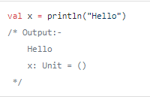
So, the println function returns a unit. The unit is like a void in Java programming.
However, it is not exactly same as void.
The void means nothing whereas unit has a value. We represent the unit value using () symbol.

Slide 40
So, the point that I wanted to make is that every statement in Scala can return some value.
Even a Scala loop and println can return a value.
Since a Scala statement returns a value, some people do not call them a statement.
They call them an expression. So, it is common that you find people saying that Scala does not have statements but only expressions.

Slide 41
Benefits of Expressions over Statements
When you start practicing Functional Programming approach, you will realize that using functional statements allows us to reduce the number of variables in our code.
Removing the variables from your code helps you to achieve immutability.
I mean, If you do not have a variable, you do not need to mutate it. Let's come back to the myResult function.

Slide 42

The code that we listed earlier is imperative. Let's make a functional version of the same code.
The if statement returns a value hence we do not need a variable. The functional version of the code is concise, and the returning statement helps us to eliminate variables and achieve immutability.

Slide 43

Tuples
Scala tuple combines a fixed number of items together so that they can be passed around as a whole.
Unlike an array or list, a tuple can hold objects with different types but they are also immutable.
The following is an example of a tuple holding an integer, a string, and the console.

Slide 44

Which is syntactic sugar (short cut) for the following
The actual type of a tuple depends upon the number and of elements it contains and the types of those elements.
Thus, the type of (99, "Luftballons") is Tuple2[Int, String].
The type of ('u', 'r', "the", 1, 4, "me") is Tuple6[Char, Char, String, Int, Int, String]

Slide 45

Tuples are of type Tuple1, Tuple2, Tuple3 and so on.
There currently is an upper limit of 22 in the Scala if you need more, then you can use a collection, not a tuple.
For each TupleN type, where 1 <= N <= 22, Scala defines a number of element-access methods. Given the following definition

Slide 46

To access elements of a tuple t, you can use method t._1 to access the first element, t._2 to access the second, and so on. For example, the following expression computes the sum of all elements of t.

Slide 47
You can use Tuple to write a method that takes a List[Double] and returns the count, the sum, and the sum of squares returned in a three-element Tuple, a Tuple3[Int, Double, Double].
They are also useful to pass a list of data values as messages between actors in concurrent programming.
Try the following example program. It shows how to use a tuple.

Slide 48
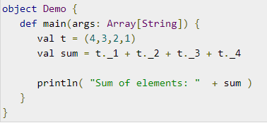
Example
Save the above program in Demo.scala.
The following commands are used to compile and execute this program.

Slide 49


Commands
Output

Slide 50
THANK YOU

